Slide 1
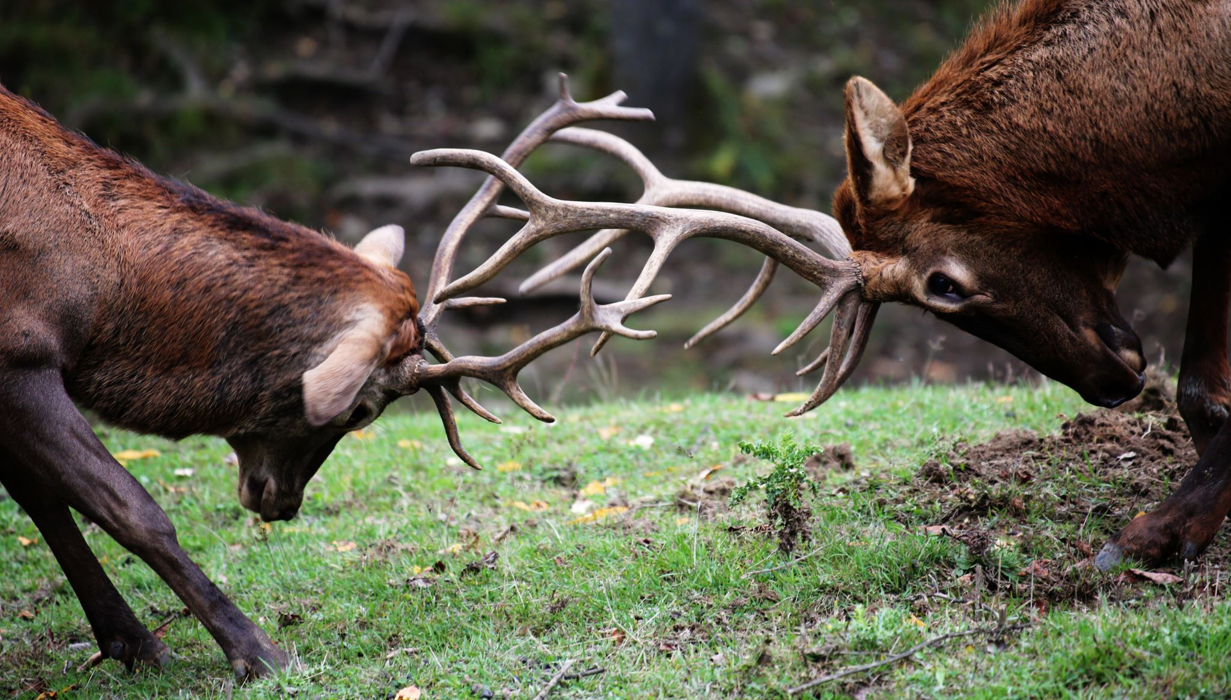
What Animal Could You Beat in a Fight?
Jacob Hefele

Slide 2

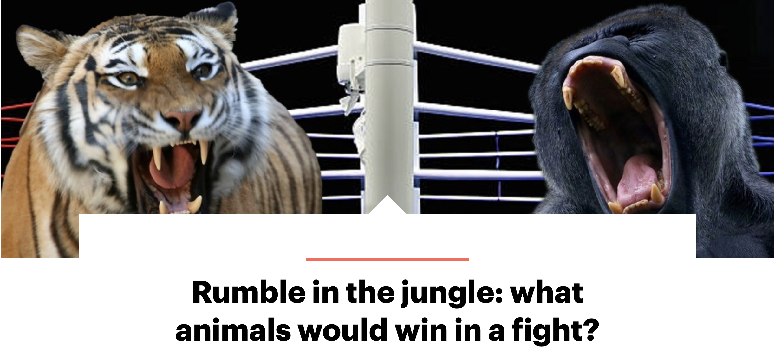
YouGov Article
Polls Americans to understand trends especially in politics
1,224 adults were surveyed
Deadliest animals?
Which animals could they defeat in an unarmed fight?
Highlights overconfidence in males
https://today.yougov.com/society/articles/35852-lions-and-tigers-and-bears-what-animal-would-win-f

Slide 3
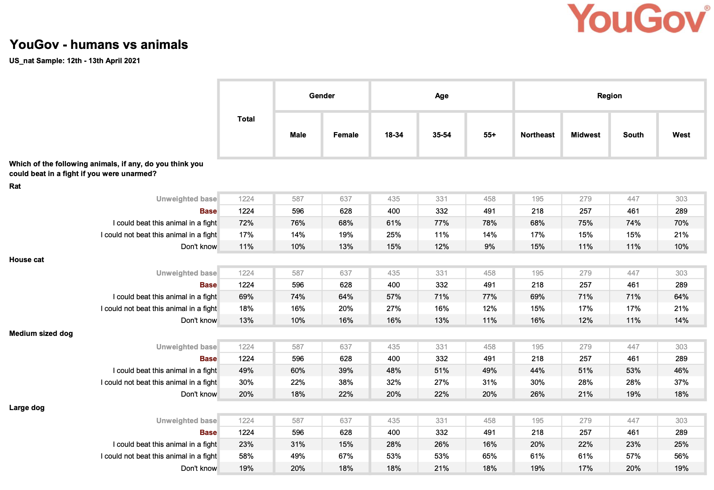

Slide 4
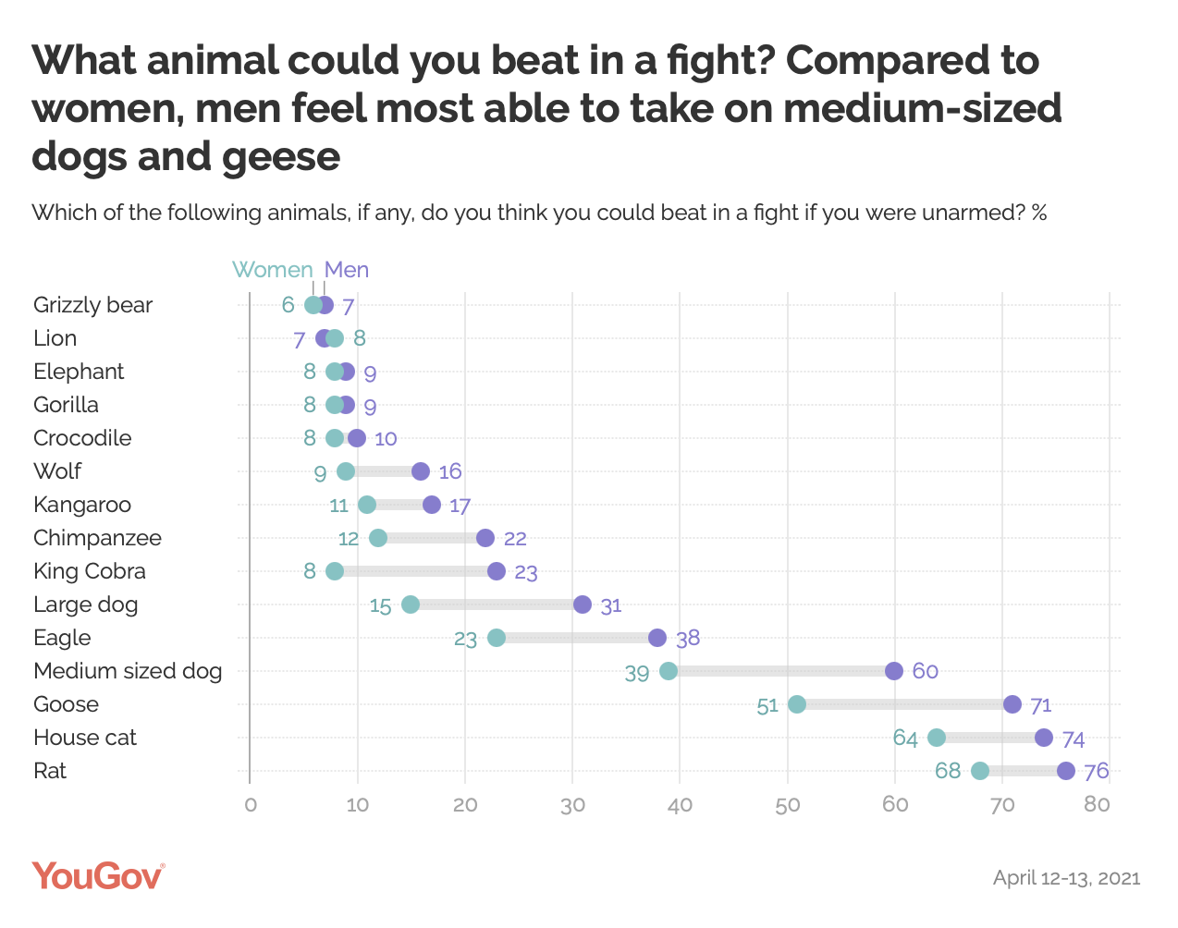
Flaws
Format unclear
Too many grid lines
No total
More data?

Slide 5
Goal of Redesign
Show more variables than gender
Make it interactive
Highlight confidence differences in gender
Give stylized, eye-catching theme

Slide 6
